Slide 1



Alcohol Consumption in Russia
Felicia Onwudinjo
July, 8th PARIS
DAFT July 22

Slide 2
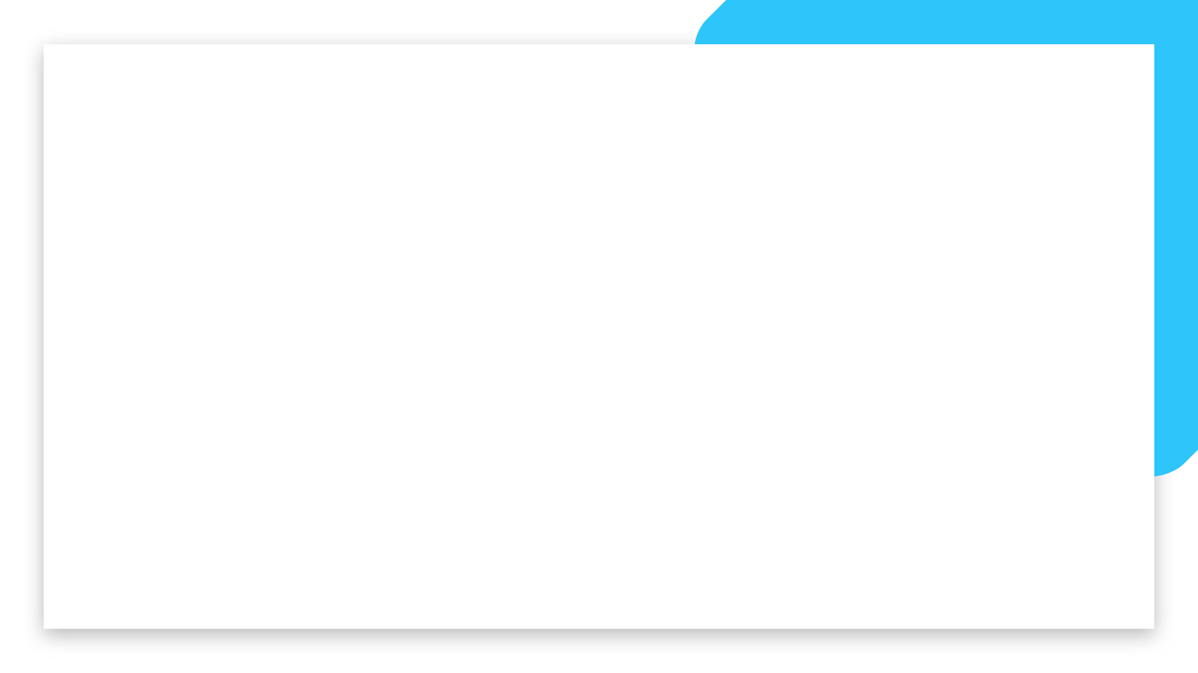
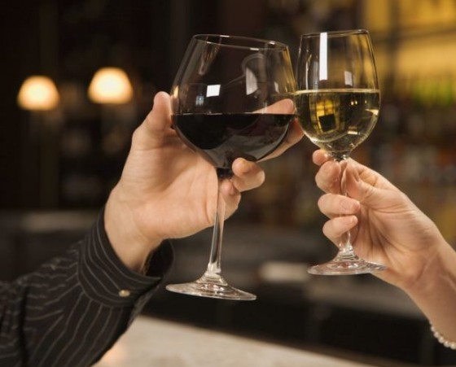
Business case
A company in Russia owns a chain of store that sells a variety of types of alcohol. The company recently ran a wine promotion in Saint Petersburg that was very successful. Due to the cost to the business, it isn't possible to run the promotion in all regions. The marketing team would like to target 10 regions that have similar buying habits to saint Petersburg where they would expect the promotion to be similarly successful.
Notes:
This project is about identifying patterns in unlabelled dataset which makes it unsupervised machine learning and clustering appears to be the most reasonable choice of the model. Since the size of the dataset is relatively small and we only really care about identifying regions similar to Saint Patersburg, hierarchical clustering appears to be the method of choice. Once we complete clustering, we will need to rank the regions from the same cluster as Saint Petersburg to select top 10. To be able to do to the ranking successfully, we need to have a good understanding of what makes Saint Petersburg different from other regions. This will allow us to to prioritize the regions in the optimal way.

Slide 3
Plan
Here's the plan of analysis to implement this approach:
Data importation and cleaning
Exploratory Data Analysis (EDA) .
Selecting and engineering the clustering variables (features).
Implementing clustering .
Ranking the regions from the same cluster as Saint Petersburg .
Notes:
Exploratory Data Analyis (EDA) to visualize average trends across all regions and trends in Saint Petersburg region to highlight the difference.
Selecting and engineering the clustering variables (features) based on the resutls of EDA.
Implementing clustering and tuning the parameters to get to a tight group of regions.
Ranking the regions from the same cluster as Saint Petersburg for the final recommendations.

Slide 4
About Data
The dataset contains historical sales volumes per capita for several different alcoholic drinks types from 1998 - 2006.
The data set was goten from kaggle and scrapped from ЕМИСС (UIISS) - Unified interdepartmental information and statistical system.
Single Interdepartmental Information and Statistical System (SIISS) (tadviser.com)
Meta Data
"year" - year (1998-2016)
"region" - name of a federal subject of Russia. It could be oblast, republic, krai, autonomous okrug, federal city and a single autonomous oblast
"wine" - sale of wine in litres by year per capita
"beer" - sale of beer in litres by year per capita
"vodka" - sale of vodka in litres by year per capita
"champagne" - sale of champagne in litres by year per capita
"brandy" - sale of brandy in litres by year per capita

Slide 5
Data cleaning and Data preparation
For the data cleaning preparation we went through the following steps:
Handling missing values.
Check for uniqueness of region names
Check for Dtypes.
Creating coordinates
Checking for outliers

Slide 6
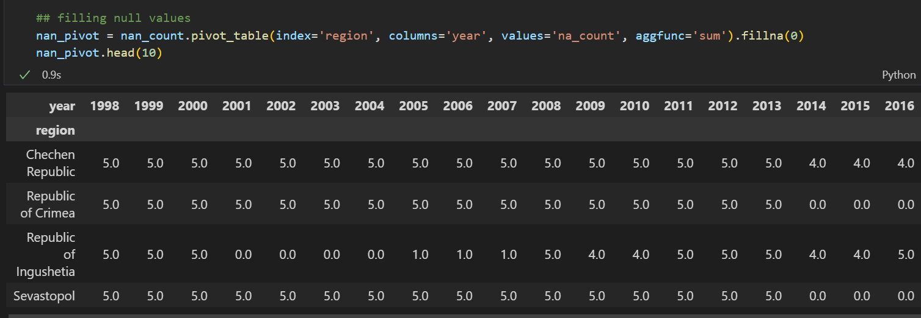
Missing values
Notes:
Handling missing values
Based on the counts above, it would make sense to completely drop regions with most of the data missing - Chechen Republic, Republic of Crimea, Republic of Ingushetia and Sevastopol

Slide 7
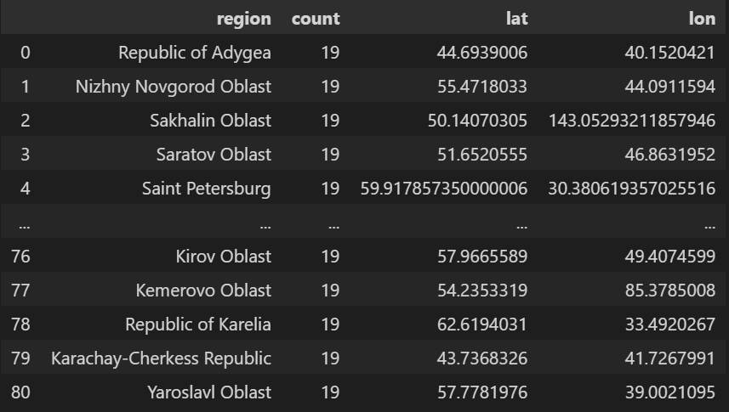
Creating Coordinates
Notes:
We used the geopy library in python to create coordinates
### Geo Location
For geolocation, we need to get coordinates to display stat on the map. For that we need:
* geopy -> Nominatim
* creating user agent to connect to geopy server.
* create lat and lon function to extract latitude and longitude using the name of the place.
* value count the region column, resetting index, and then renaming columns.
* applying both functions on to geo['region']
* export the file as "russian_geo.csv"
This process takes 5 minutes to run so we are just going to save the results in a .csv file and later merge it with our main database.

Slide 8
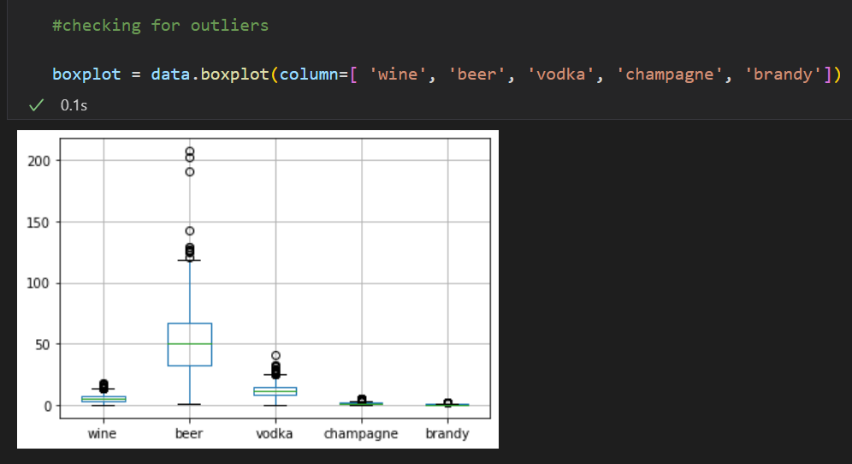
Outliers

Slide 9
EDA
Business questions
Before making a recommendation to the marketing team, we shall focus on answering the following business questions:
How does the alcohol consumption in Saint Petersburg compare to that in other regions?
How does the sale of wine correlate with the sale of other drinks?
Can we identify regions that show an overall similar alcohol consumption pattern as Saint Petersburg over the years?
Can we find correlations with the sales of other drinks in regions with a similar wine consumption as Saint Petersburg?

Slide 10
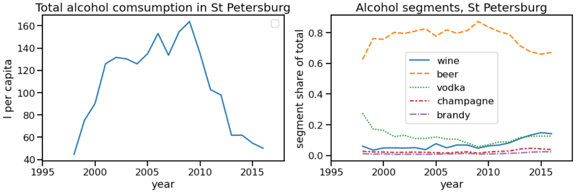
How does the alcohol consumption in SPB compare to other regions?
To achieve this we need to first look at the total alcohol consumption in SPB alone
Notes:
Conclusions
* Overall alcohol consumption peaked in 2010 and steadily declined after dropping back to pre-millenial levels
* Beer represents the highest share of all segments and was the driver of peak and decline
* Wine share of alcohol consumption has been steadily growing across observed period while other segments were mostly flat.
Now let's compare these trends with national averages.

Slide 11
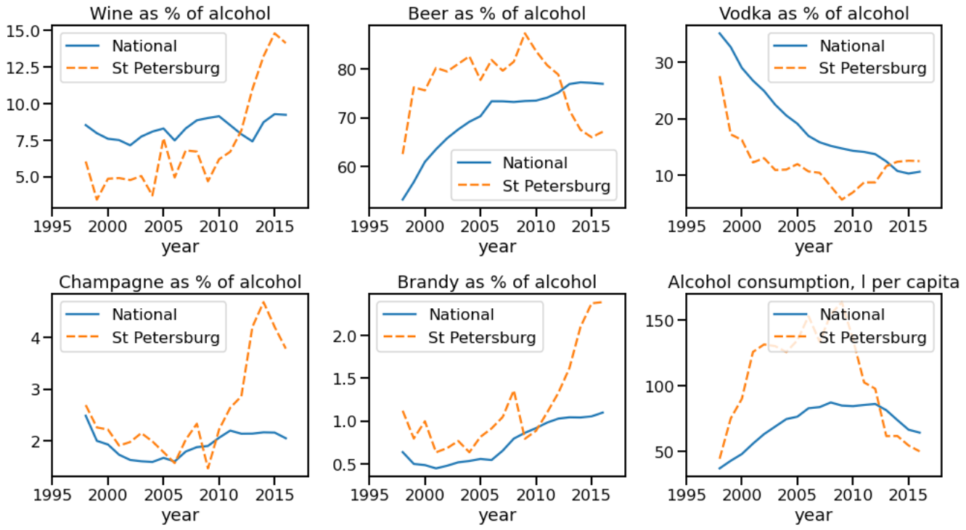
Alcohol consumption in SPB compare to National average regions
Notes:
Conclusion
The wine consumption in Saint Petersburg is above average when compared to other regions in Russia, fluctuating between 7 and 8 liters per person per since 2009. A similar pattern is visible in the consumption of champagne and brandy. In comparison to other regions, people in Saint Petersburg consume less beer.
Like other regions in Russia, the vodka consumption in Saint Petersburg has dropped rapidly over the last decade. This fits with the conclusions from a recently published report from IWSC that states that younger people tend to favor wine, whereas the older generation prefers spirits.
The market in Saint Petersburg can therefore be defined as having a high wine, brandy and champagne consumption, but a low beer and vodka consumption.

Slide 12
Conclusion
The wine consumption in Saint Petersburg is above average when compared to other regions in Russia, fluctuating since 2009. A similar pattern is visible in the consumption of champagne and brandy. In comparison to other regions, people in Saint Petersburg consume less beer.
Like other regions in Russia, the vodka consumption in Saint Petersburg has dropped rapidly over the last decade. This fits with the conclusions from a recently published report from IWSC that states that younger people tend to favor wine, whereas the older generation prefers spirits.
The market in Saint Petersburg can therefore be defined as having a high wine, brandy and champagne consumption, but a low beer and vodka consumption.

Slide 13
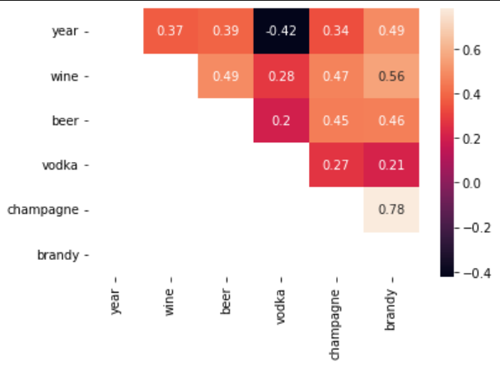
How does the sale of wine correlate with the sale of other drinks?
Notes:
Conclusion
Pearson’s Correlation coefficient is a measure for the strength of a linear relationship between two variables. A coefficient between 0.3 and 0.5 is generally considered as weak, meaning that the two variables show no strong linear relationship. A coefficient between 0.5 and 0.7 is considered as moderate, whereas a correlation between 0.7 and 0.9 is considered strong.
There is an overall moderate positive relationship between the consumption of wine and the consumption of brandy, indicating that regions that have a high wine consumption also tend to have a high brandy consumption. The correlation between wine consumption and both champagne and beer consumption balances on the edge of a weak and moderate. This could very well be an economic effect, indicating that regions that have a higher income tend to spend more money on alcohol.
It is intersting to see that there is only a weak relationship between wine and vodka consumption. Again, this fits with the idea that wine drinkers and generally younger Russians that want to distance themselves from the high-alcohol drinking observed by older generations and preferring a lower-alcohol drink to show sophistication. Reference.
Overall we could conclude that most wine is consumed in regions that also sell large
amounts of brandy (and to a lesser extent beer and champagne). This cannot be said for the vodka market, as vodka tends to be consumed by the older generation, whereas wine is preferred by the younger generation.

Slide 14
Can we identify regions that show an overall similar alcohol consumption pattern over the years as Saint Petersburg?
What is clustering
Clustering is a type of unsupervised machine learning that divides data points into a number of groups such that the data points within a group are more similar to other data points within the group than data points in other groups.
For the purpose of our project, we are going to use three methods of unsupervised learning.
KMeans model
DBSCAN
Agglomerative Clustering
Notes:
In order to cluster we need to:
Deal with any missing values in the dataset
Determine the optimal number of clusters (for example, using the elbow method)
Scale the dataset so that greater values are not considered as being more important than lower values

Slide 15
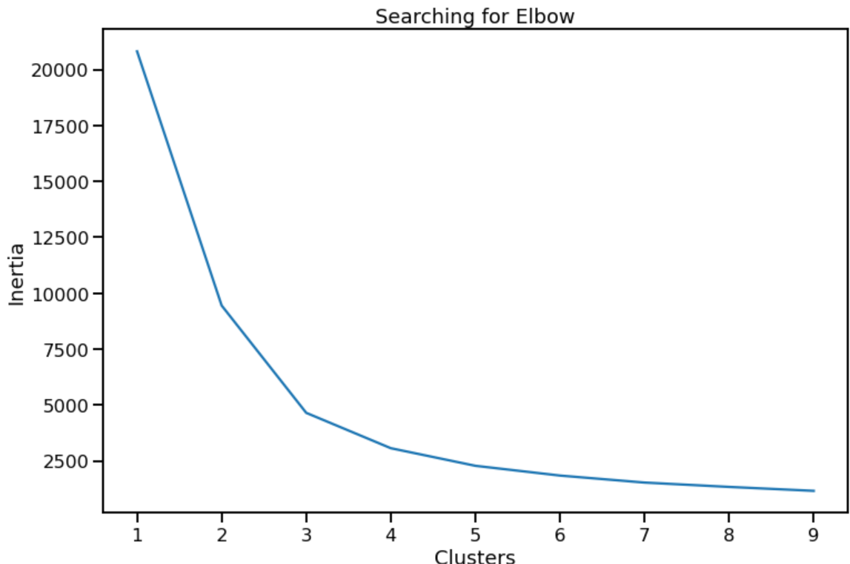
KMeans: Elbow

Slide 16
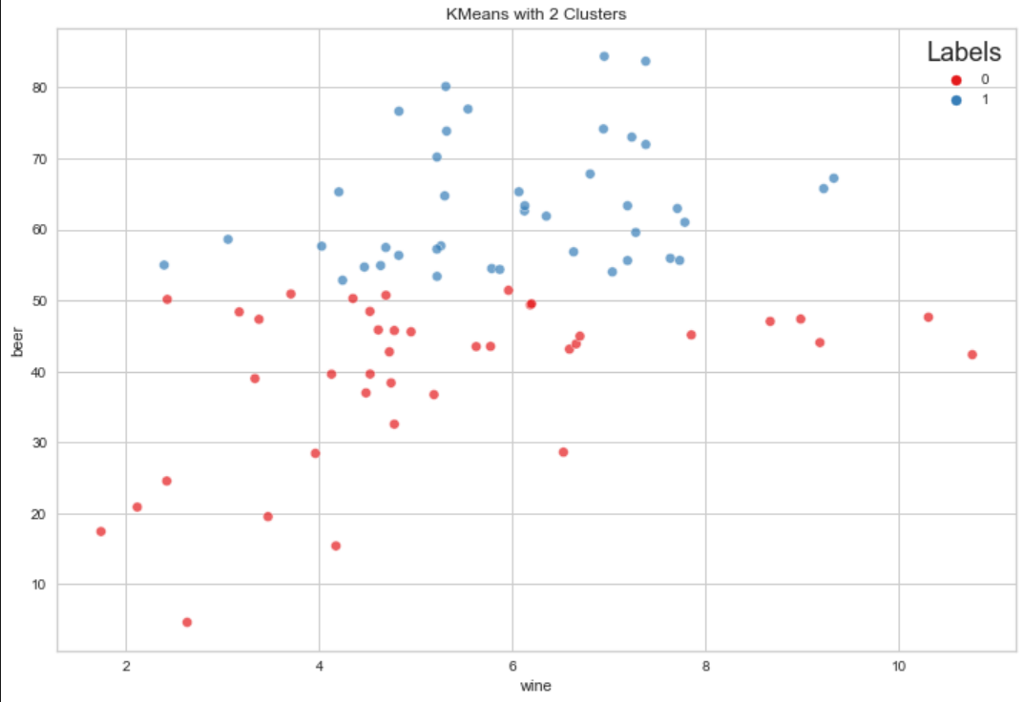
Silhouette coefficient : 0.618

Slide 17
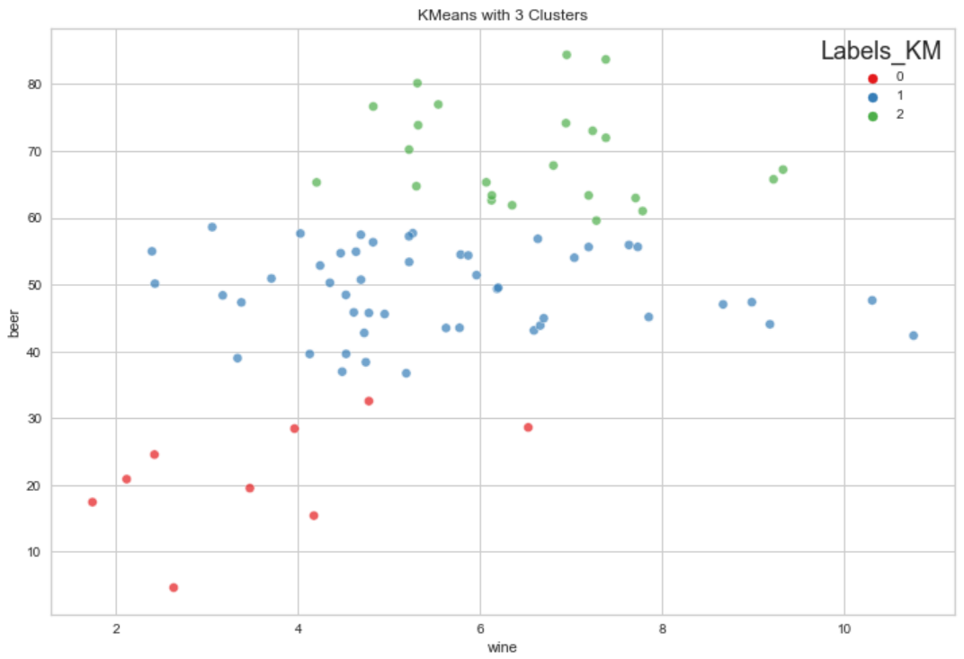
Silhouette coefficient : 0.710

Slide 18
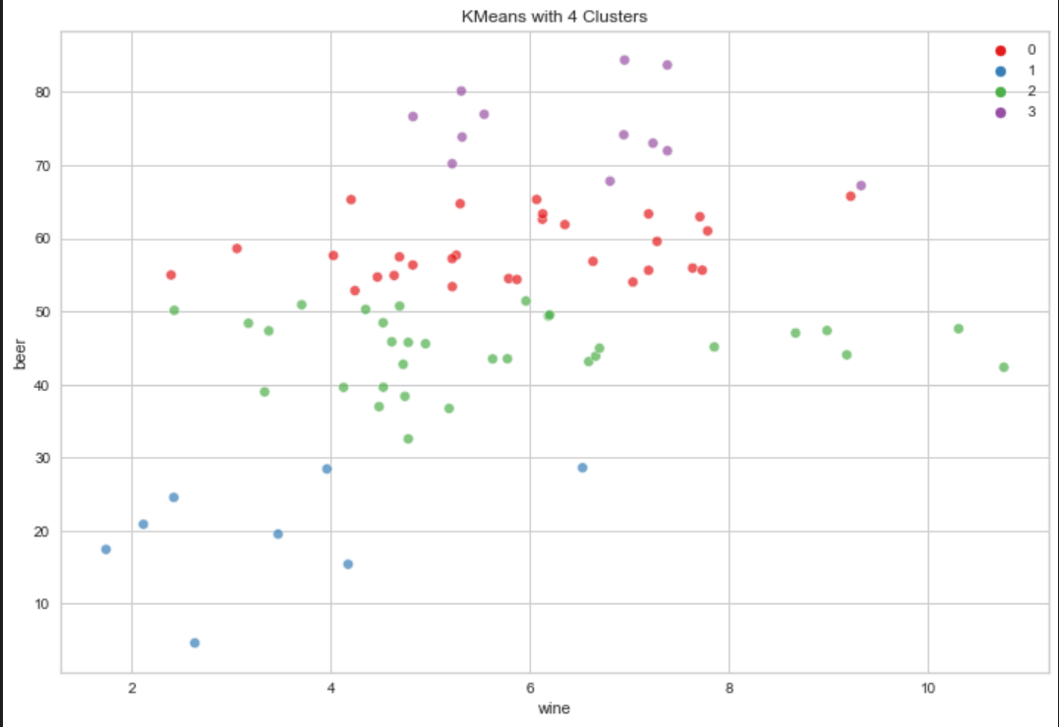
Silhouette coefficient : 0.636

Slide 19
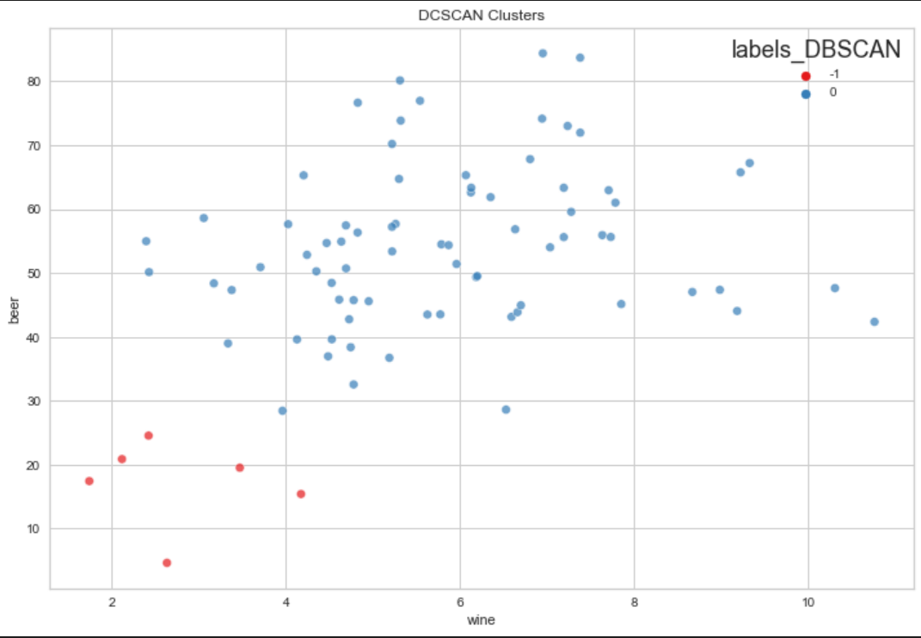
DBSCAN
Silhouette coefficient : 0.713

Slide 20
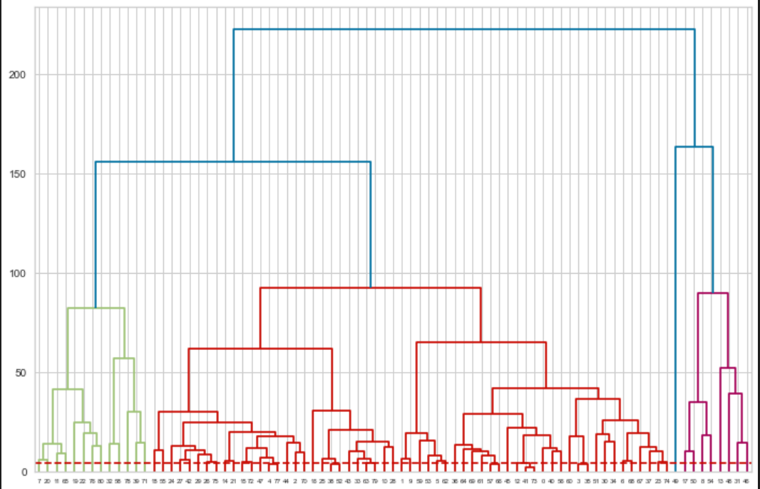
Agglomerative clustering
Notes:
We will be using scipy spatial distance_matrix to calculate the distance from each point to every other point of a dataset. The function distance_matrix requires two inputs and we are adding X and X.
We will then use scipy hierarchy linkage using the average method to create links between each cluster, which later will be used to plot the dendrogram.

Slide 21
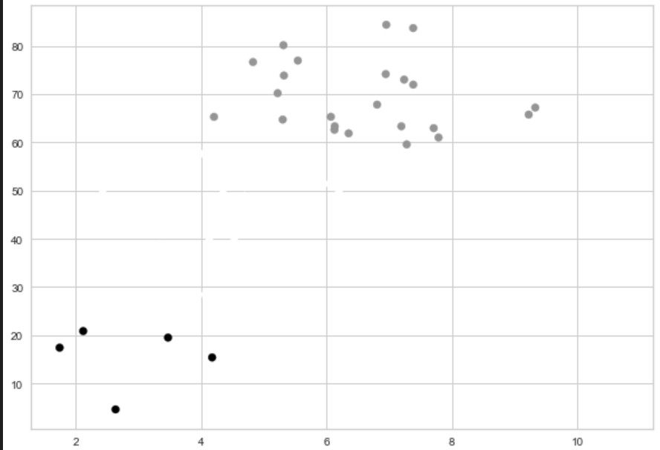
Silhouette coefficient : 0.640

Slide 22
Clusters Swarmplot
Let's visualize our results using Swamplot using the DBSCAN labels.
We can clearly see the Green has the highest average consumption in all drinks categories. They all are following similar rules of ranking and the blue is low.
We are going to use this to pick the top ten regions and products.

Slide 23
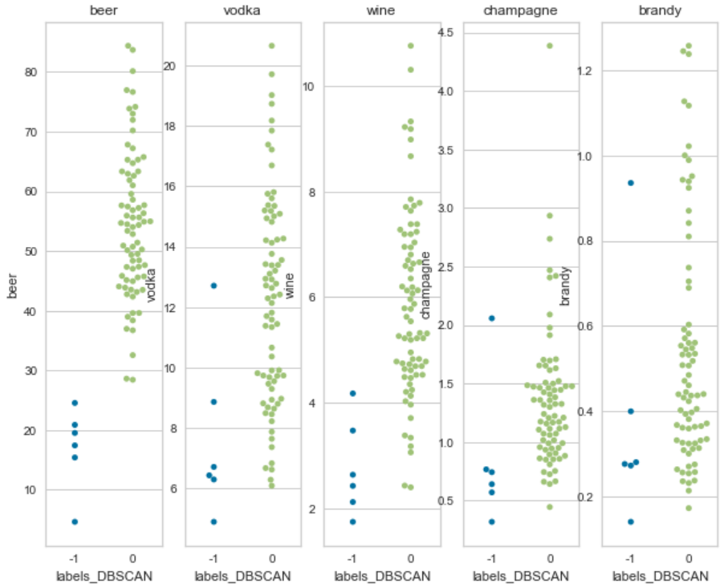

Slide 24
Main results
Categorizing Clusters
It's time to add both the Kmeans cluster, Hierarchical cluster and DBSCAN into our main database.
Creating a new column "Labels_KM", “labels_agg” and “Labels_DBSCAN”
Create a new column "Total_Drinks" and add total drinks values.
Renaming numerical values to categories based on popularity.
Filtering out to see top 10 values based on Labels_DBSCAN.

Slide 25
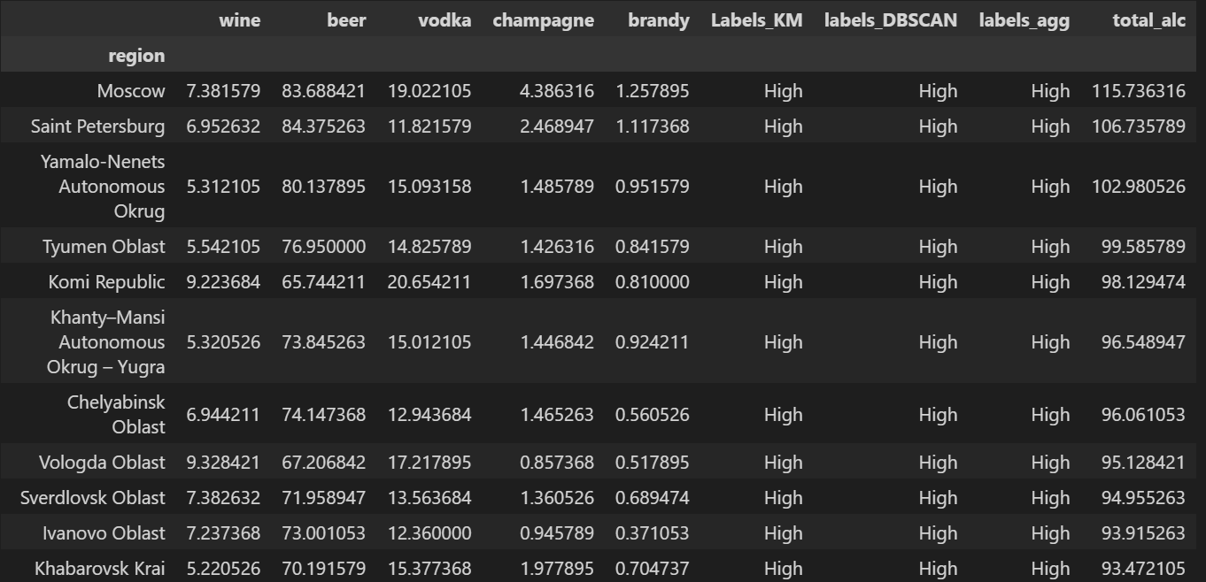

Slide 26
Results
We have finally spotted 10 regions similar to Saint Petersburg for promoting launching new marketing comparing. We have selected the cluster which is "High" on the Kmean ,DBSCAN and Herarchery cluster, then sort values on "Total_alc" to get Top ten regions for the campaign.
Notes:
1 How does the alcohol consumption in Saint Petersburg compare to that in other regions?
Saint Petersburg is a high wine, high brandy and high champagne consuming region with a low consumption of beer and vodka.
2 How does the sale of wine correlate with the sale of other drinks?
In general, we find that in regions with a high wine consumption the consumption, of other drinks (except for vodka) tends to be higher. This is likely an economic effect. The vodka market and wine market likely cater to different types of consumers.
3 Can we identify regions that show an overall similar alcohol consumption pattern as Saint Petersburg over the years?
Saint Petersburg fits nicely into a single cluster when we only look at wine, brandy and champagne consumption, but not when we also look at vodka and beer consumption. We can therefore not identify regions that show an overall similar alcohol consumption pattern as Saint Petersburg.

Slide 27
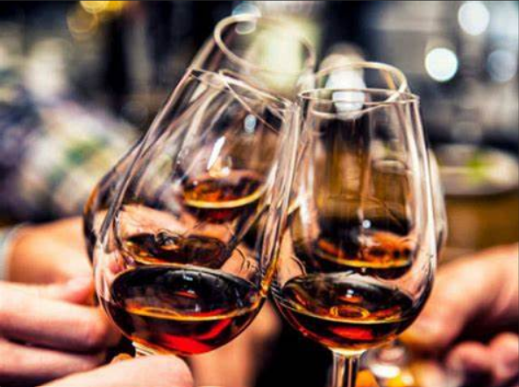
Questions?
CHEERS

